Slide 1
Tackling VAWG
In Hackney
Bianca Rembrandt,
Community Safety and Principle Enforcement Officer

Slide 2
Blackstock road - A history of street based harassment
Wikipedia entry - https://en.wikipedia.org/wiki/Blackstock_Road
7 March 2020 - Facebook Reclaim the street
https://www.facebook.com/events/finsbury-park/reclaim-the-streets-islington/511679942808484/
23 January 2020 Islington Gazette - Women urged to report sexual harassment along Blackstock road
https://www.islingtongazette.co.uk/news/crime-court/police-urge-women-to-report-sexual-harassment-in-blackstock-road-1-6479561
28 July 2011 Islington Gazette
https://www.islingtongazette.co.uk/news/crime-court/women-suffer-sexual-harassment-in-finsbury-park-street-1-975332

Slide 3
Neighbourhood Watch - Are You okay? Project
Partnership working with Neighbourhood Watch - Lynne Troughton Hackney’s Neighbourhood Watch Champion setting up watches.
16 Days of Activism to tackle VAWG. I saw the ‘Are you okay?’ street harassment campaign as part of my research into tackling VAWG and thought the messaging was brilliant and so simple.
Partnership working is at the heart of community safety so I contacted Cheryl Spruce who was promoting the Community Safety Charter which I also promoted in Hackney and she put me in touch with Deborah Waller who led on this project and we talked through how we could promote this in the area with posters and had thought about posters on the lamppost and we created a multi-face poster.

Slide 5
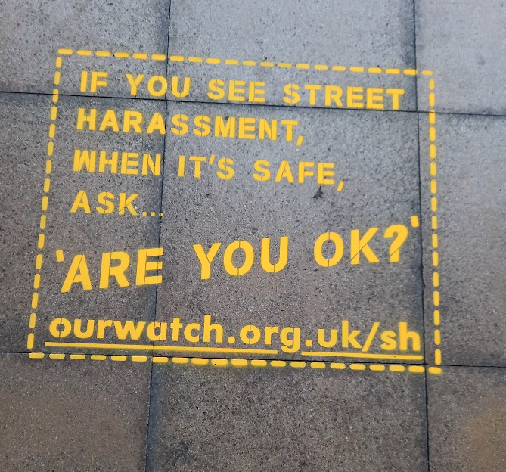
Floor Stencils

Slide 6
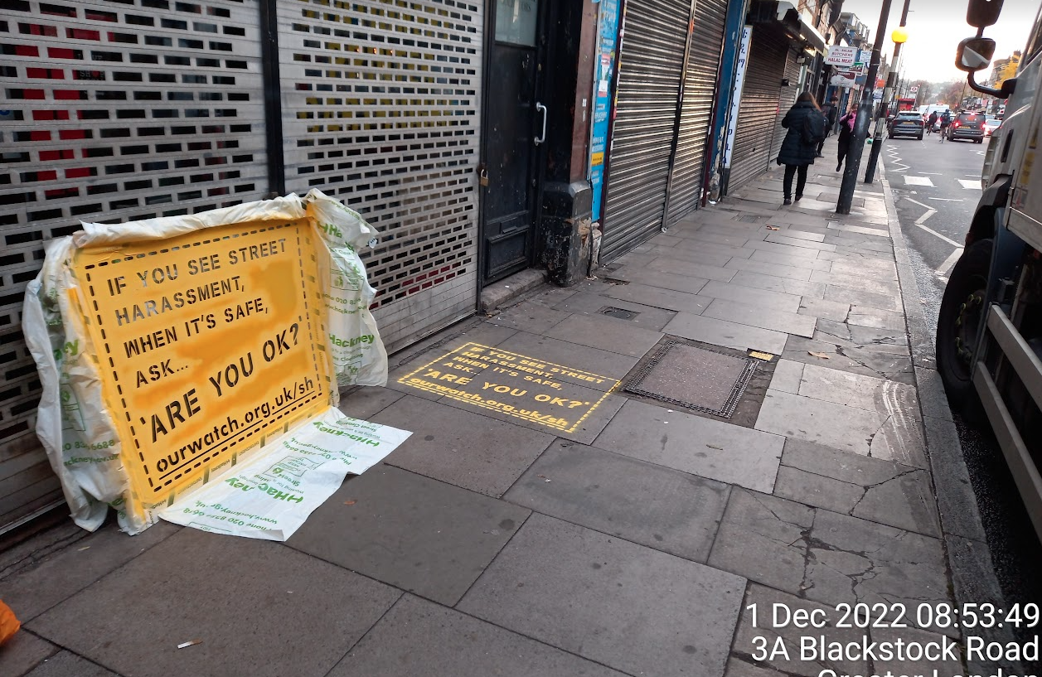
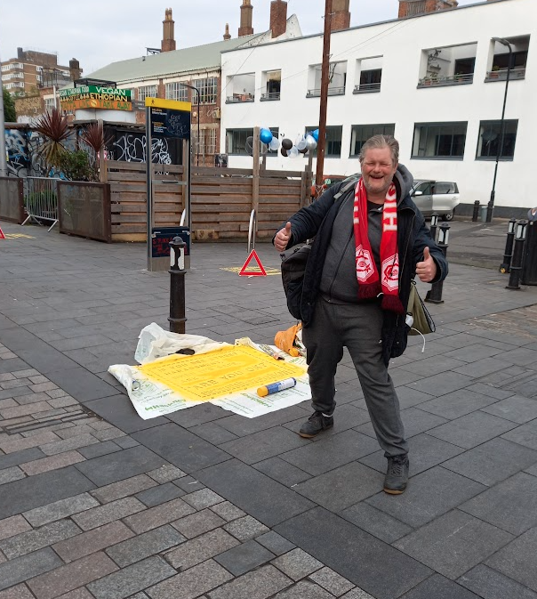
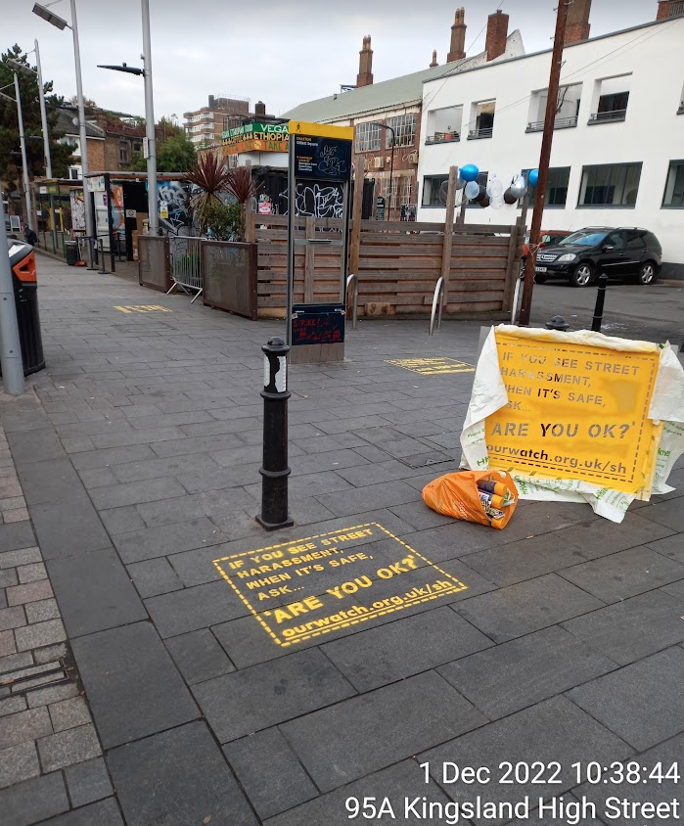
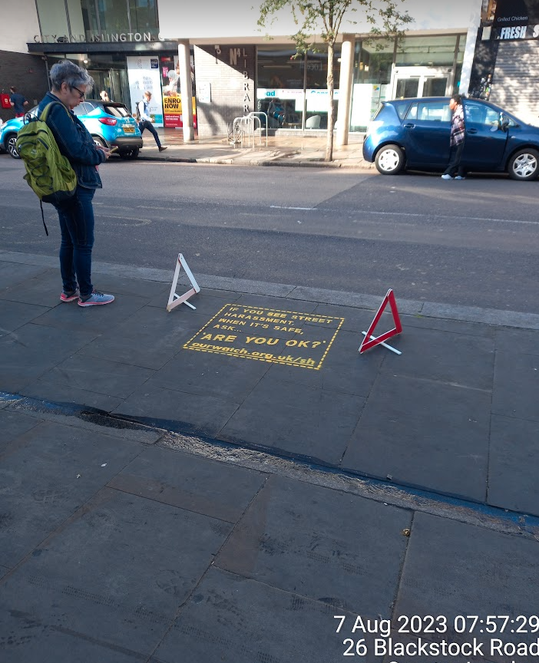
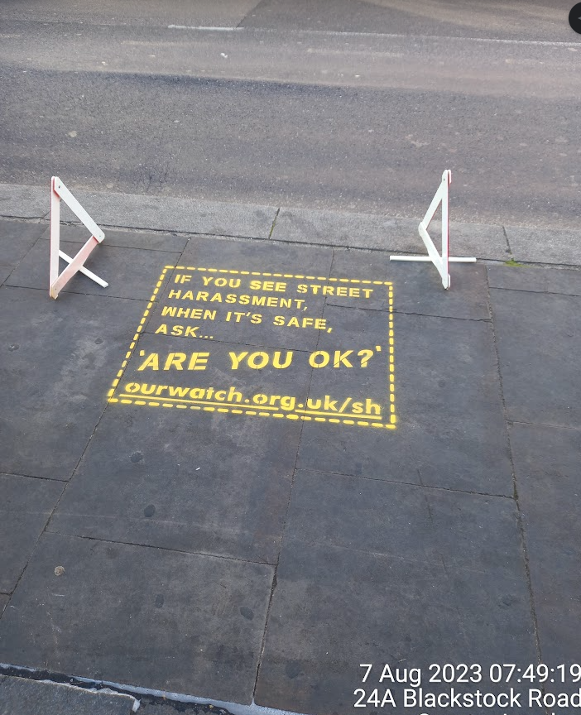
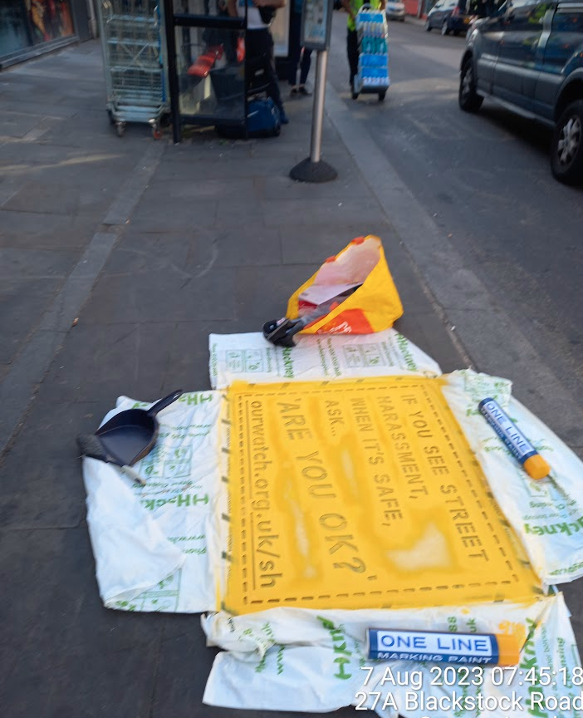

Slide 7
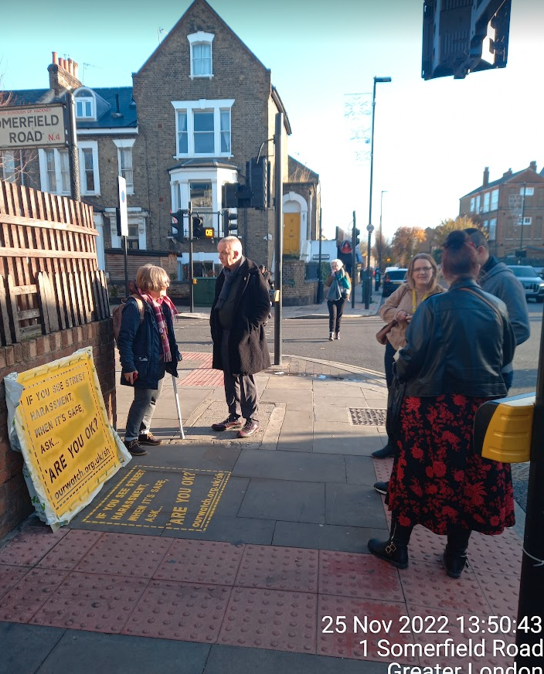
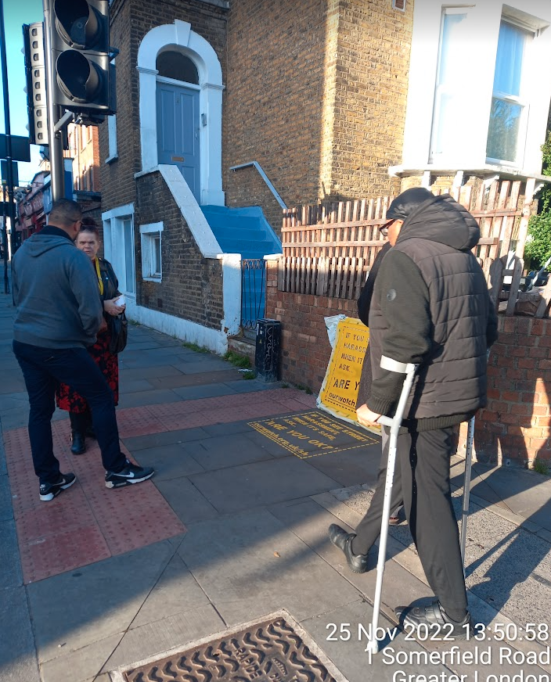
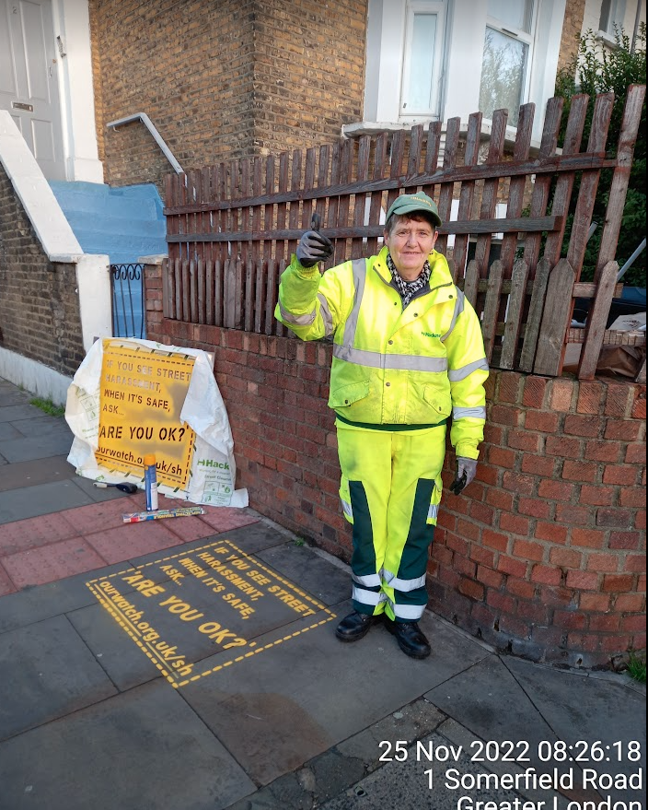
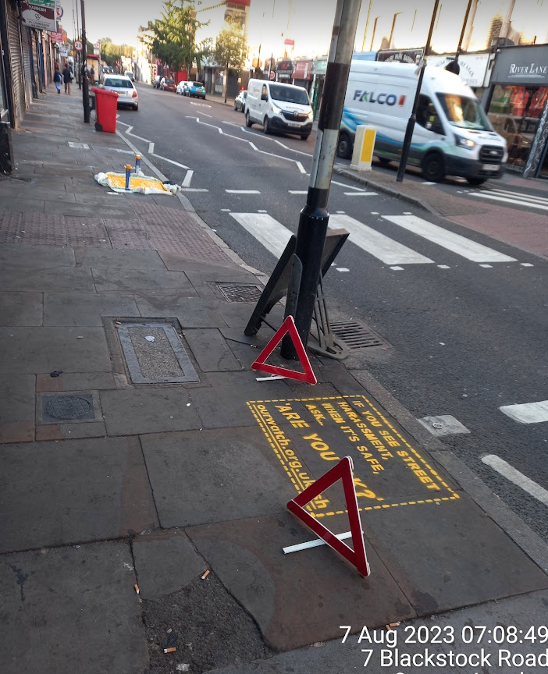
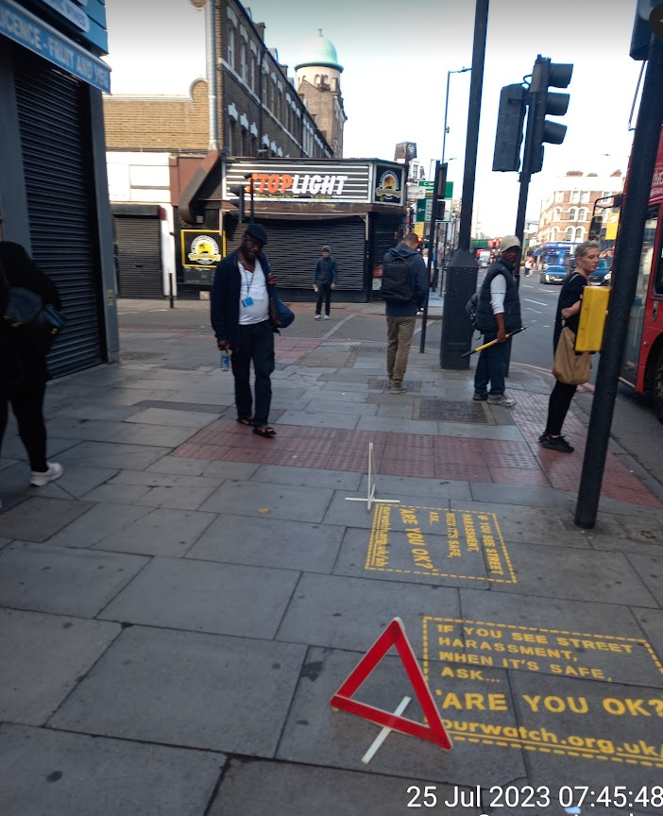
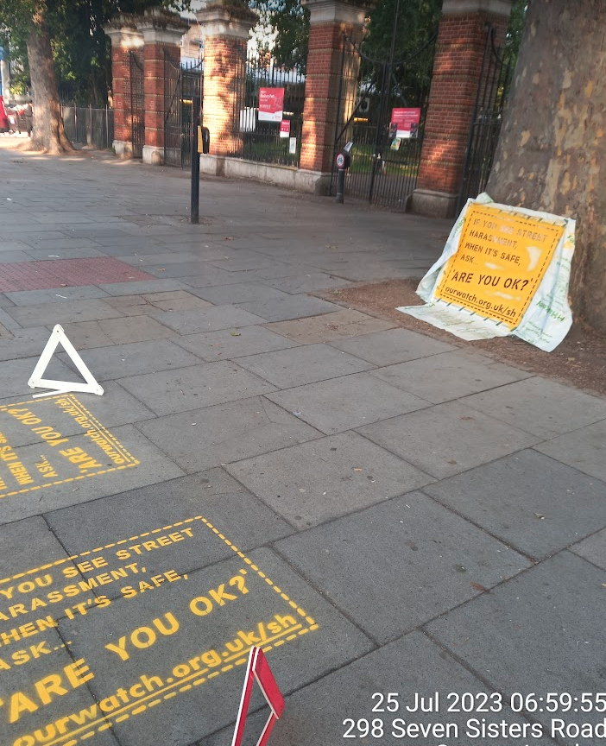

Slide 8
Tips and Advice - PLAN AHEAD
Seek support from:
your local ward councillors
Community safety portfolio holder
and police
Seek approval from Highways (Local authority), Street Cleansing (Local Authority )Transport For London (if applicable), or a private landlord (if applicable)
Decide on how many and the best location to place stencils. Remember to:
pick a spot where pavement slabs are even and flat
ensure stencils point in both directions so people can read ahead of them as they walk up and down
Purchase items needed such as:
A stencil – The recommended size is 70x90cm
Stencil material - Aluminium

Slide 9
Cont….
Spray cans (750ml) – ideally in yellow or teal to match size, Neighbourhood Watch’s brand. Each can could spray up to 6 stencils. Approx £4.50 a can.
A high viz jacket – to draw the attention of members of the public and also encourage conversation about violence against women and girls and street-based based harassment
Protective clothing (PPE) - old clothes, gloves, mask and eye protection
Small brush pan to sweep the area and remove any debris before spraying. You may want to ask the street cleaning team to clean an area if it is bad
Red cones or warning signs to ensure people do not walk on the sign when it is drying
5. Plan which day it will be sprayed. Consider the weather and make sure that
it is not going to rain over a 24-hour period
there are no or low wind speeds

Slide 10
Tips and Advice - ON THE DAY
It is best if two people can work together to do the stencilling. Having two stencil templates means you can do more in a shorter time
Consider installing stencils in the early hours or late evening before the flow of people on the street increases
Set up the cones or signs to ensure people do not walk on the sign when it is drying
Follow the instructions on the spray paint and spray accordingly
Leave the stencil in place for 3 to 5 minutes before lifting it up. The more air to the stencil the quicker it will dry
Wait 30 minutes (sometimes less than that) for it to be touch dry. Remember it will take 24 hours for most spray paint to fully cure

Slide 11
Tips and Advice - WHEN THE STENCIL IS LAID
Observe people’s reactions and hand out material directing them to the Neighbourhood Watch pages on street harassment – ourwatch.org.uk/sh and other partnership websites and links
Take photos and raise awareness of them via social media (tagging Neighbourhood Watch Network) and by contacting the press
Approach shop owners and invite them to sign up to the Community Safety Charter - ourwatch.org.uk/charter
Store the stencil in a ventilated room until next use

Slide 12
FEEDBACK
Raising awareness and Promotion
Interaction and engagement with the public
Sharing and Supporting (you may need to make referrals or reports)
Sowing a seed
Starting and having and the conversation…
Non verbal communication - Thumbs up or smiles
The Negatives….?

Slide 13
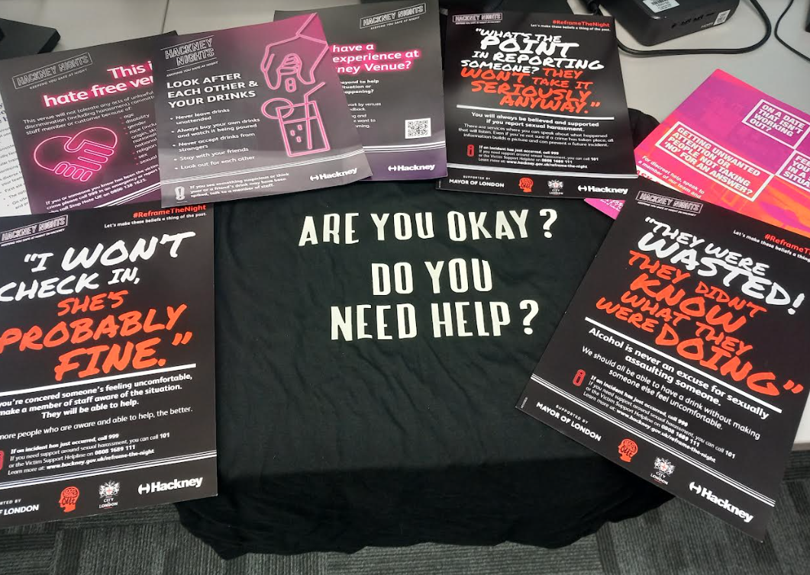
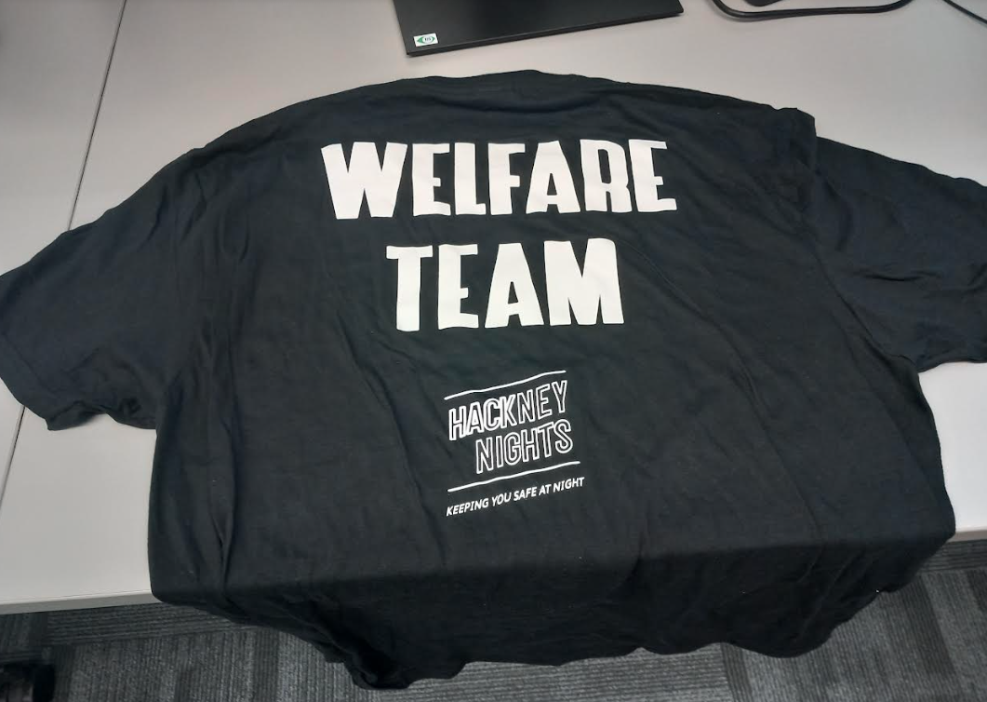
Inspiration: Hackney Nights - Are you okay - T-Shirts?

Slide 14
