Slide 1
A new met for London
Working together to deliver
More Trust, Less Crime and High Standards

Slide 2
Sir Robert Peel
“
The police are the public and the public are the police, the police being only members of the public who are paid to give full-time attention to duties which are incumbent on every citizen in the interests of community welfare and existence.
”

Slide 3
Our context

Slide 4
More trust
Less crime
High standards

Slide 5
Community crime-fighting
Culture change
Fixing our foundations

Slide 6
Our values:
Respect
Integrity
Empathy
Courage
Accountable
Our principles:
Communities-first
Frontline-focused
Inclusive
Collaborative
Precise

Slide 7
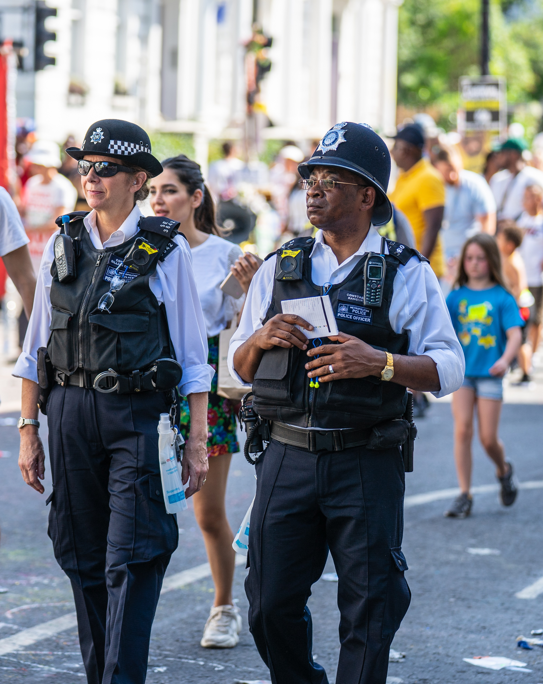
We’ve made some progress, but there is much more to do.

Slide 8
HOW CAN WE BETTER WORK TOGETHER?

