Slide 1
Citizen volunteers in policing and community safety: A changing role in changing times
Dr Melissa Pepper (with Professor Karen Bullock)
School of Law and Criminology, University of Greenwich
Image: Our Watch

Slide 2
Citizen volunteers: Neighbourhood Watch and beyond
Citizen volunteers in policing and community safety
Neighbourhood Watch study: Reflecting back, looking forward
The role of volunteers in changing times

Slide 3
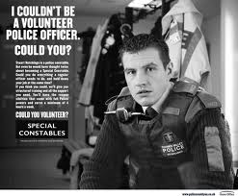
Citizen volunteers feature throughout policing and community safety

Slide 4
Significant volunteer volume – and significant volunteer contribution
Case study: Police Support Volunteers (PSVs)
7,632 PSVs
190,000 hours
(significantly impacted by Covid-19 pandemic)
1,100 role profiles
Source: IPSCJ Police Support Volunteer National Benchmarking Exercise 2018/2021

Slide 5
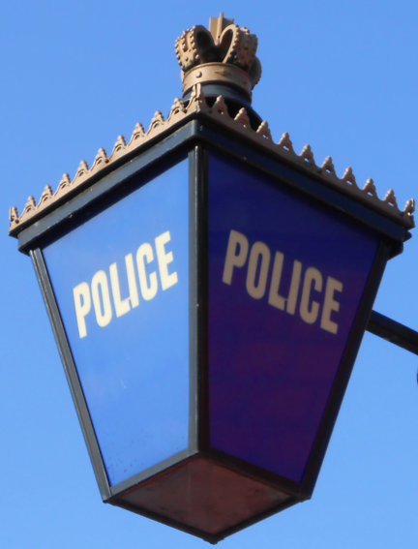
Motivations
The altruistic volunteer
The social volunteer
The career volunteer
Experiences
Infrastructure

Slide 6
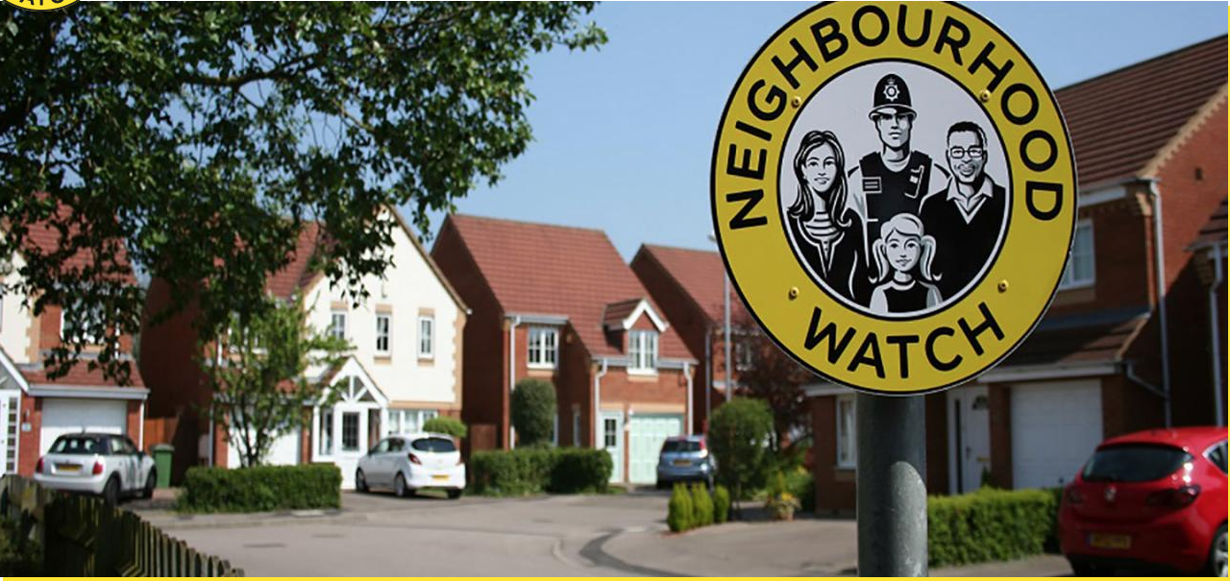
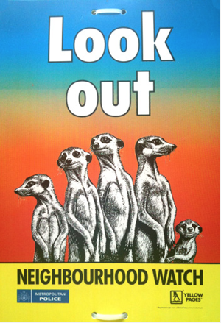
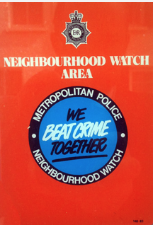

Slide 7
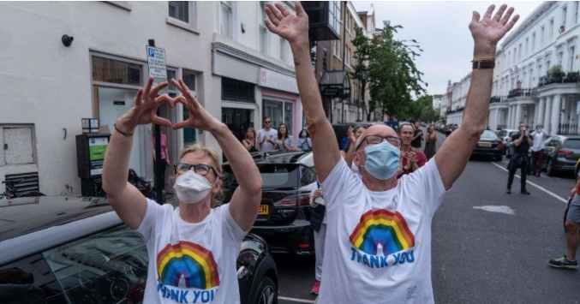
BBC News, 6 January 2021

Slide 8
Reflecting back and looking forward

Slide 9
Three headline findings so far
Challenging stereotypes: Neighbourhood Watch is flexible and changing
Technology is important: But only one of the ‘tools in the box’
A diffusion of benefits: ‘It’s not just about crime...’

Slide 10
Challenging stereotypes: Neighbourhood Watch is flexible and changing
It’s a reputation…of curtain twitching, being older, well-off, white and kind of middle class… it is a bit of a lazy stereotype (Daniel, stakeholder interviewee)
It’s about the values…looking out for each other…how you want to do it – that’s up to yourselves because all communities are different (Gareth, stakeholder interviewee)
In order to stay relevant we need to use various methods of communication as opposed to just a (traditional) Watch (Shirani, stakeholder interviewee)
Photo source: Our Watch website

Slide 11
Technology is important: But only one of the ‘tools in the box’
Anything that brings communities together, and WhatsApp has got…a lot of positives about it, because that’s been an easy way for people to recognise that they can communicate with neighbours quite easily (Ash, Neighbourhood Watch member focus group attendee)
Social media has been a great tool to reach more people. It isn't a Neighbourhood Watch, it's a way of communicating the messages out
(Kate, stakeholder interviewee)
You’ve got be very careful about this thing about technology is the answer to all prayers. I don’t think it is – because we’re all human beings
(Peter, Neighbourhood Watch Co-ordinator interviewee)

Slide 12
A diffusion of benefits: ‘It’s not just about crime...’
It’s the sense of community that it builds or represents in a way beyond the prevention of crime…it helps to drive that sense of community action where not just one person is carrying the burden along, it’s a community shared burden (Ash, Neighbourhood Watch member focus group attendee)
Photo source: Our Watch website
I think it’s as much from a community point of view as a crime point of view…if you’ve got a good strong community, you each are looking out for one another all the time
(Connie, Neighbourhood Watch Co-ordinator interviewee)
People’s pride in the community is much higher and they feel responsibility to their neighbours…so then crime comes in as a natural addition to that…people are looking out for each other. And even if they don’t realise it at the time, actually they are making their place safer (Kate, stakeholder interviewee)

Slide 13
A changing role in changing times
Understanding the volunteer ‘offer’: Greater clarity on purpose and role.
Reimagining the volunteer role: Processes and patterns of ‘being’ a volunteer do not have to mirror those of ‘being’ an employee.
Adequately resourced infrastructure: Understanding motivations; meaningful contributions; recognition and value

Slide 14
(A new) Life begins at 40?
Joint working; shared resources
Bringing together the local and national
Moving beyond perceptions of ‘curtain twitchers’ and ‘fading stickers in porch windows’

Slide 15
Dr Melissa Pepper School of Law and Criminology University of Greenwich m.j.pepper@greenwich.ac.uk

