Slide 1
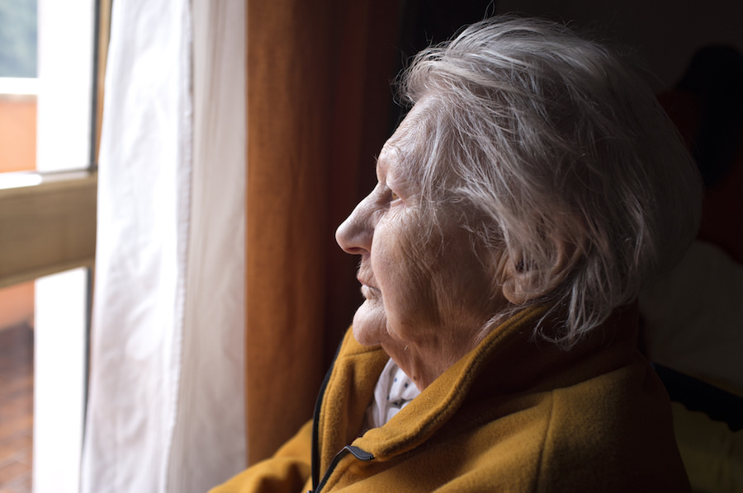
LONELINESS & VULNERABILITY
“For far too many people, loneliness is the sad reality of modern life”
Prime Minister Theresa May

Slide 2
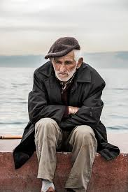
A WIDESPREAD PROBLEM
Loneliness is an emotional response to isolation or lack of meaningful companionship. It is widespread:
1 in 20 adults always or often feel lonely
Age UK estimates that at least 1 million older people are lonely
2.4 million people suffer from chronic loneliness
3 in 10 people over 80 report feeling lonely
Only 22% of people never feel lonely

Slide 3
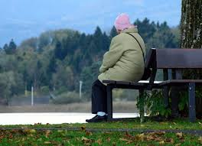
OLDER PEOPLE
The Community Life Survey suggests that around 200,000 older people in England have not had a conversation with a friend or relative in more than a month.
Loneliness affects people of all ages, but is often triggered by certain life events such as bereavement, divorce, retirement or declining health.
Social isolation and loneliness can be a key factor in making older people more vulnerable to a range of problems, from health issues to becoming a victim of crime, abuse or exploitation.

Slide 4
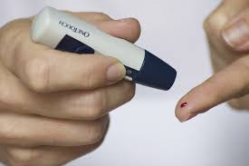
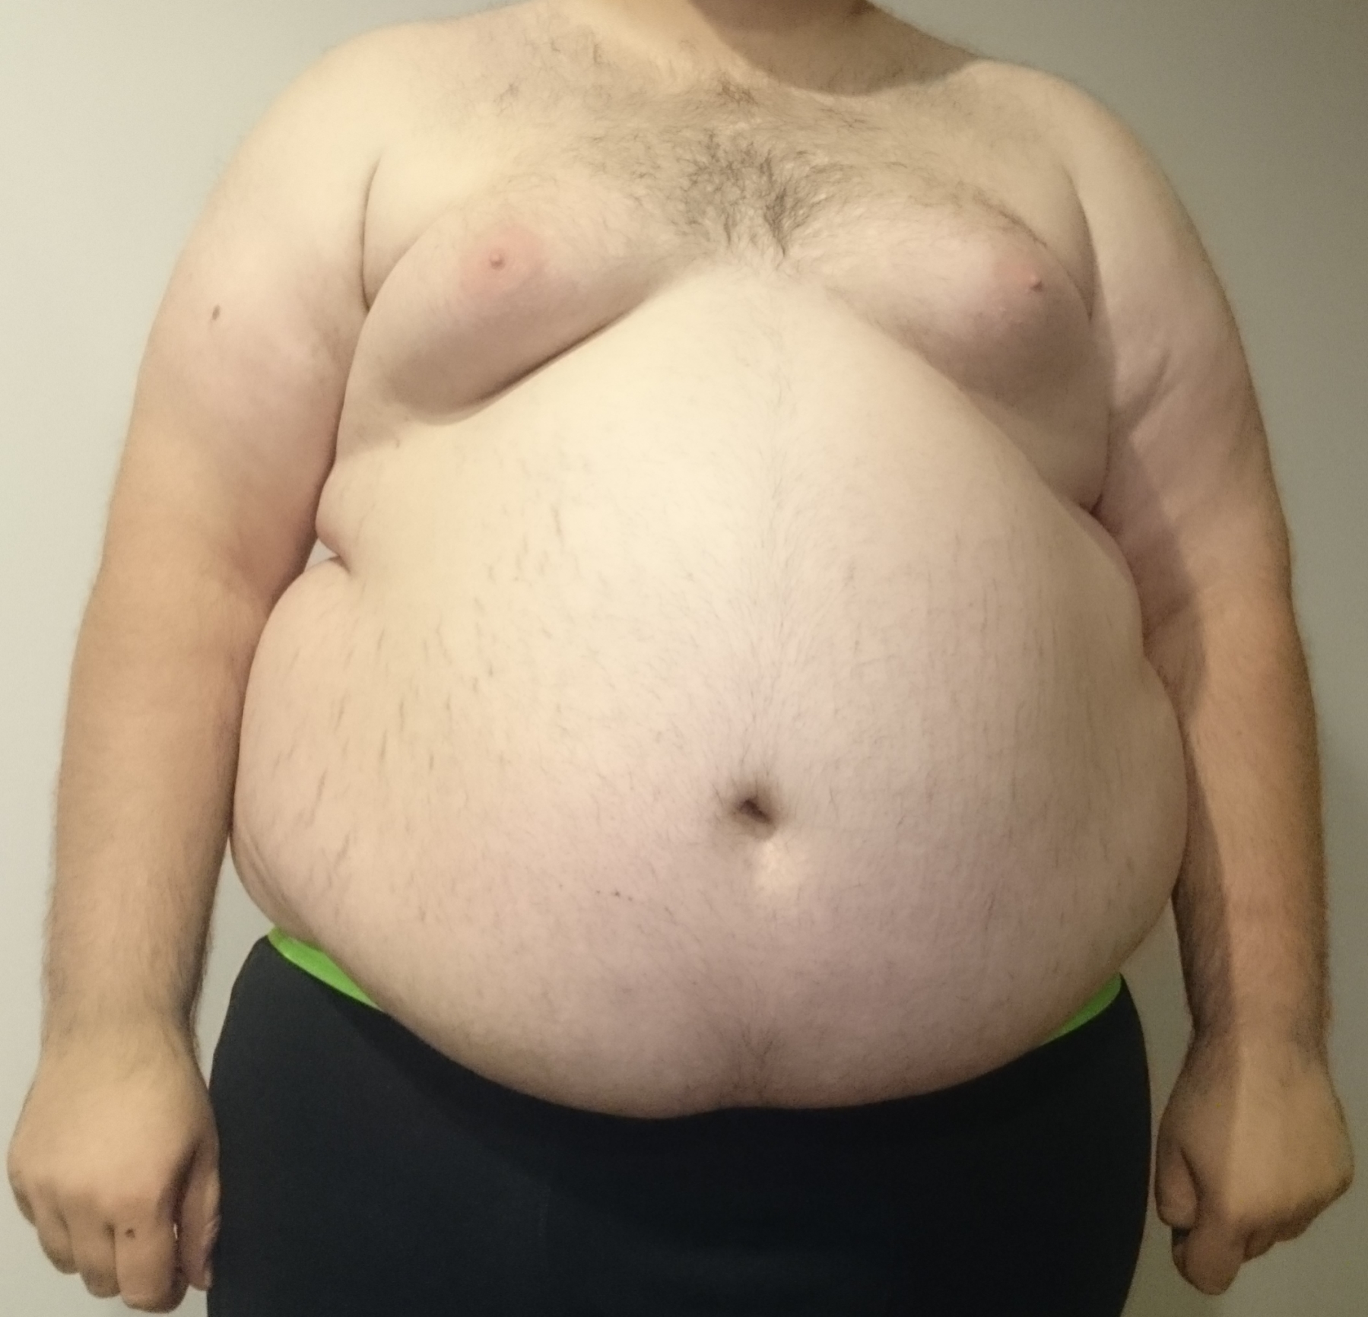
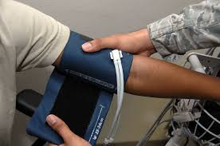
HEALTH IMPACTS
Being lonely can be as harmful to older people’s health as a chronic long-term condition…
Diabetes
Worse than obesity
As harmful as smoking 15 cigarettes a day
High blood pressure

Slide 5
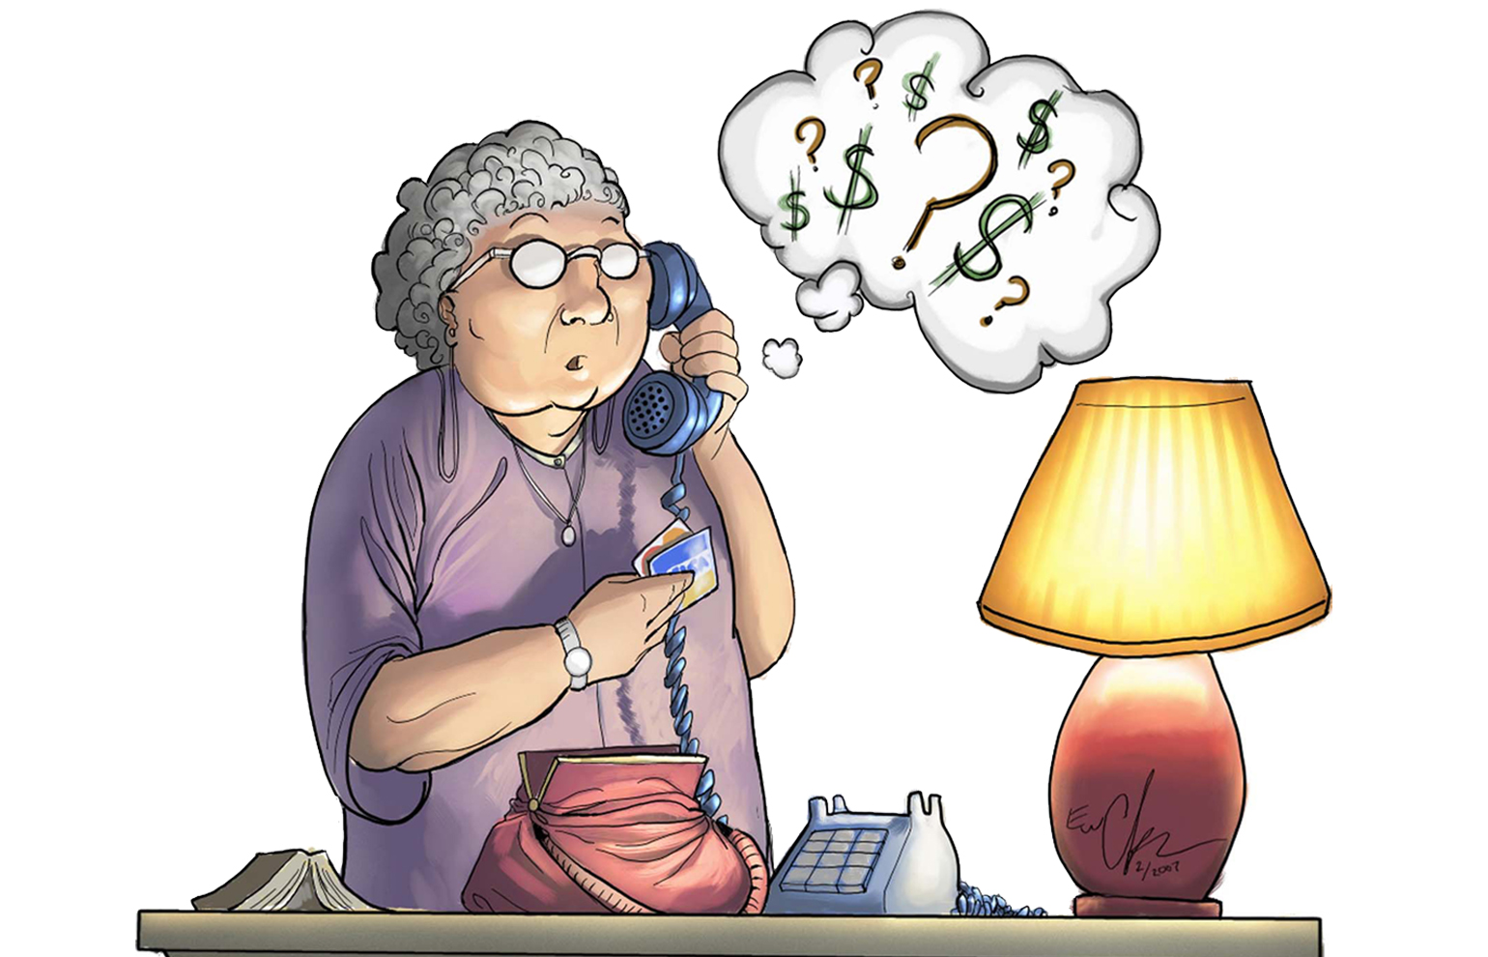
VULNERABLE TO SCAMS
Loneliness can also increase older people’s risk to falling victim to scams. The prospect of making conversation with another person can make them people more willing to open the door to a stranger, or engage in a phone conversation with an unknown caller, or respond to emails or letters.
Professional scammers are skilled at developing relationships with their targets, and before long the lonely householder begins to feel that a genuine relationship is building. This can make it very hard to convince the person that they are being scammed.
Lonely people also have fewer opportunities to meet with others and discuss finances and to explore with someone they trust whether an offer or relationship is genuine.

Slide 6
LIVING ALONE
A short film by Channel 4

Slide 7
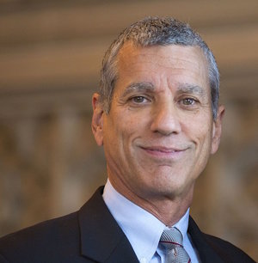
WHY DO WE FEEL LONELY?
Because human beings are inherently social creatures, feelings of loneliness arise in order to prompt us to attend to our social relationships
Just as hunger is a biological signal telling us to nourish and protect our body, so loneliness is a signal that reminds us to fulfil our social connectedness.
Attending to loneliness is important for our long-term survival.
Professor John Cacioppo, a social neuroscientist, says:

Slide 8
FUTURE TRENDS
It is predicted that between 2008 and 2033 there will be:
44%
65 to 74-year olds living alone
38%
145%
75 to 85-year-olds living alone
85+ year-olds living alone
So, while the proportion of people feeling lonely has remained fairly constant in the past, these figures may indicate that there will be an increase in the future.

Slide 9
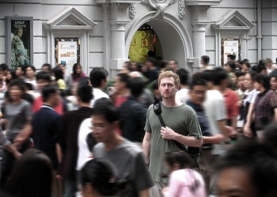
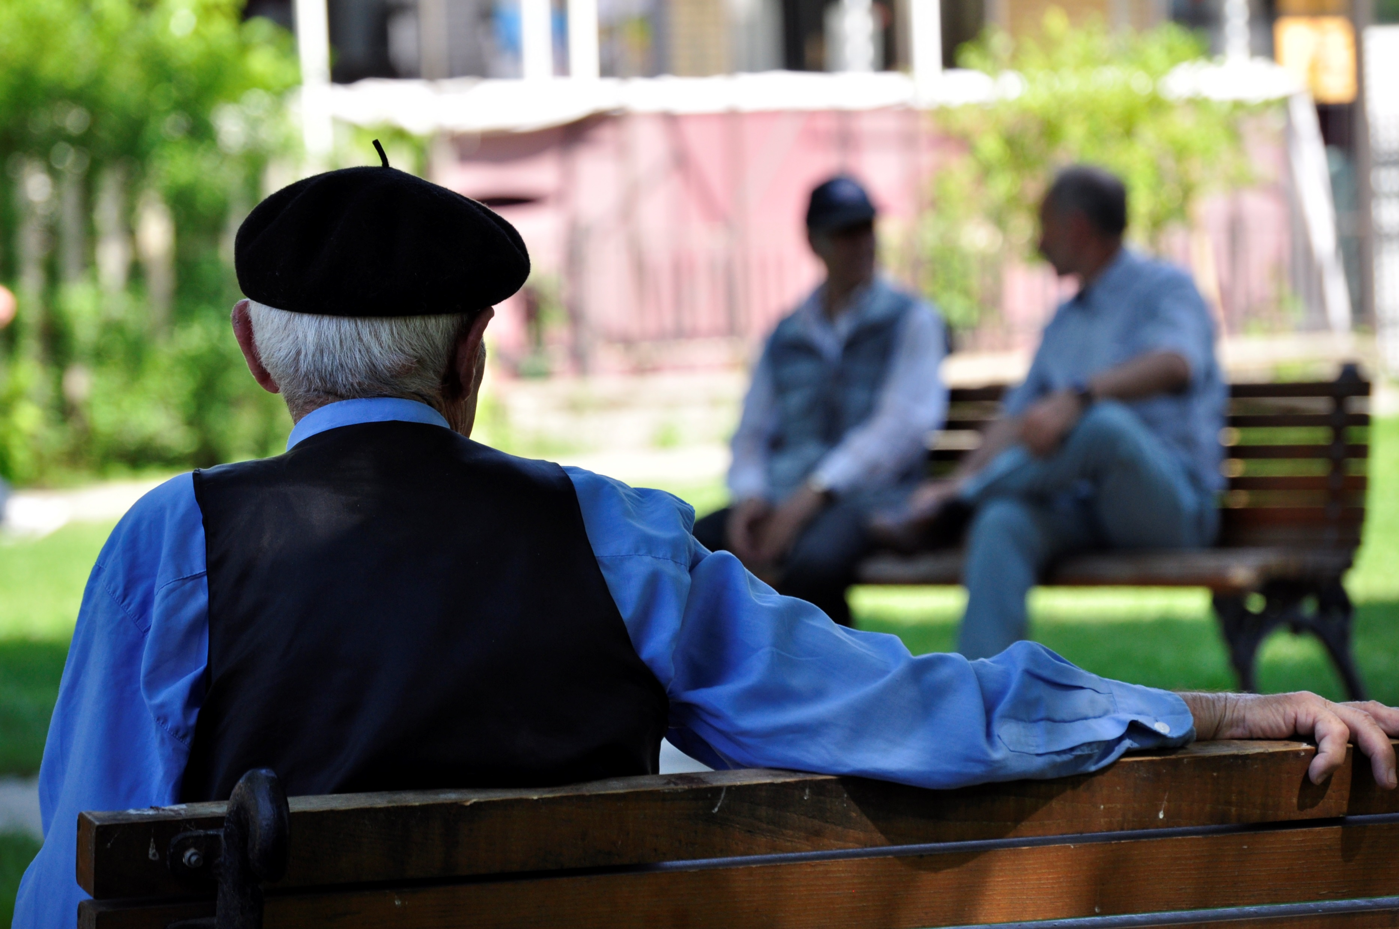
SPOTTING THE SIGNS
It’s not always easy to tell if people are lonely….
People who are socially isolated are, by definition, hard to reach and identify.
Another problem is that loneliness carries a stigma, so people don’t like to admit to it.
Not everyone who is alone feels lonely…
…and people can still feel lonely even when they seem busy and have lots of people around them

Slide 10
RISK FACTORS
Loneliness can affect people of all demographics, but various studies point to higher risk factors for certain groups of people. For instance:
Up to 85% of young disabled adults – 18 to 34-year-olds – admit to feeling lonely
8 out of 10 carers have felt lonely or isolated as a result of looking after a loved one
58% of migrants and refugees in London described loneliness and isolation as their biggest challenge.
The Community Life Survey 2016/17 identified three profiles of those at particular risk:
Widowed older homeowners living alone with long-term health conditions
Unmarried middle-agers with long-term health conditions
Younger renters with little trust and sense of belonging to their area.

Slide 11
RISK FACTORS
Research by the Campaign to End Loneliness also identified these risk factors:
Living in rural environments with poor transport connections
Having no family nearby
Having a caring responsibility
Living on a low income
Poor mobility
Losing hearing and/or sight
Having certain long-term conditions (such as dementia)

Slide 12
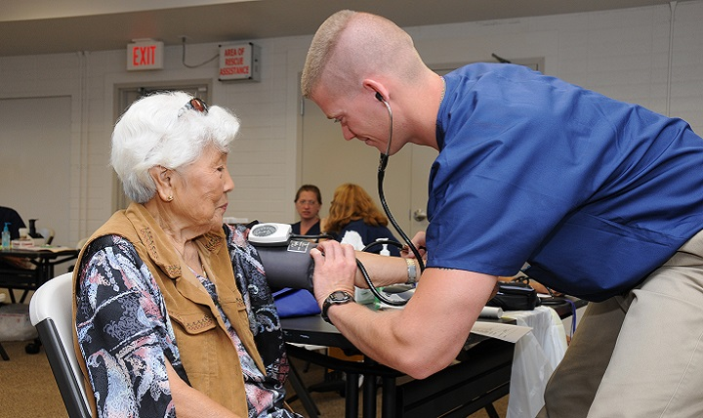
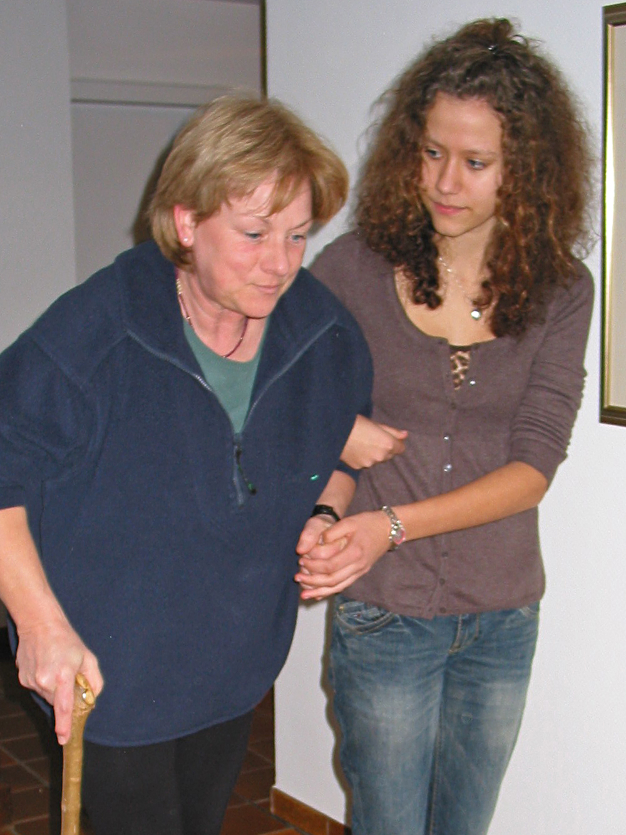
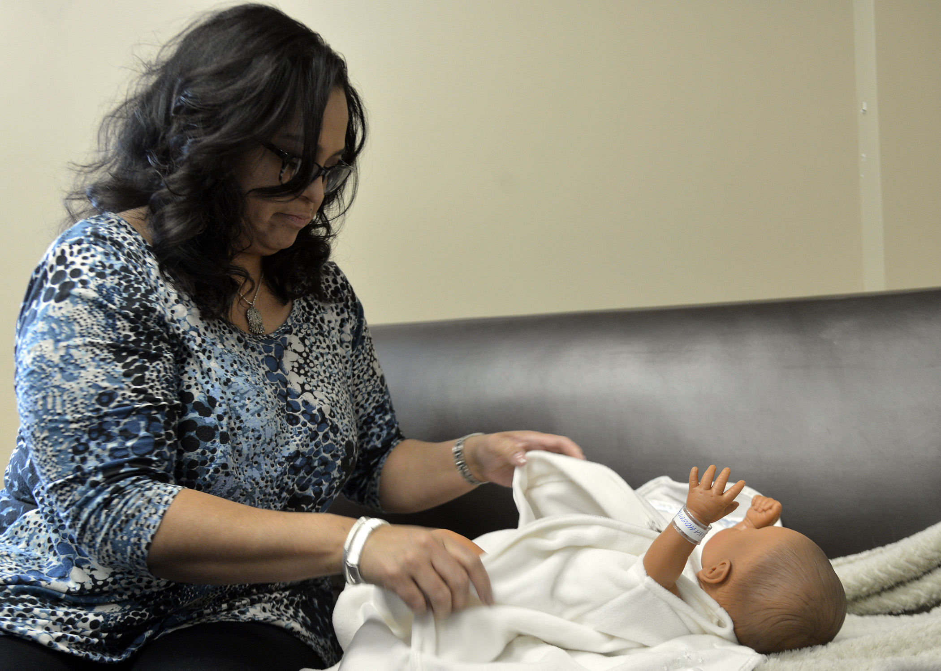
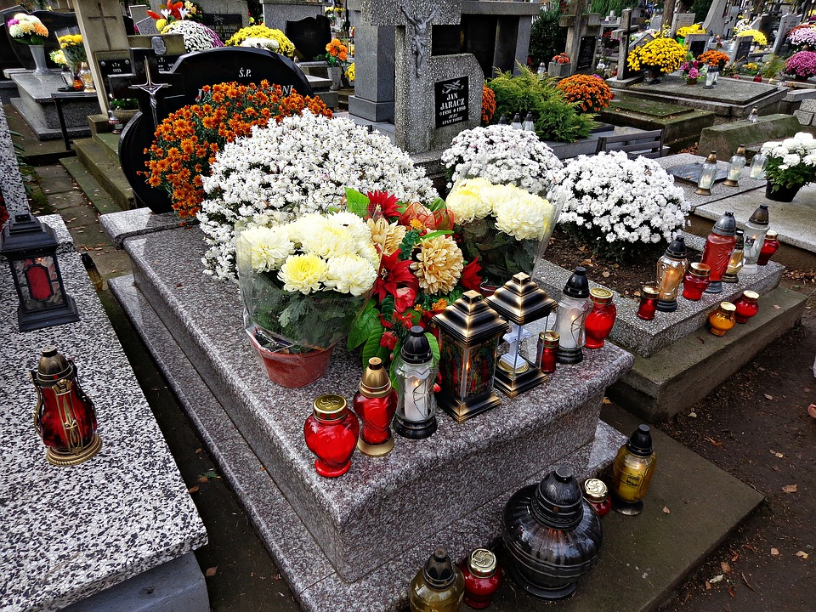
TRIGGERS
While most of us will be lonely at some stage, some life transitions can act as triggers for chronic loneliness. If you know someone who has recently undergone any of the following experiences, they could be at greater risk of loneliness:
Developing a health condition
Changing jobs
or retiring
Leaving the armed forces
Experiencing family breakdown
Becoming a carer
Moving home
Coming into the country seeking asylum
Becoming a parent
Bereavement

Slide 13
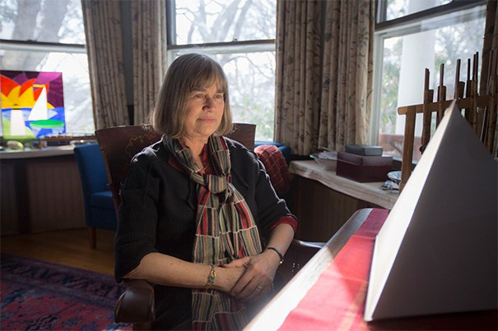
BEHAVIOURS
When people feel lonely, a ‘stepping back’ occurs.
“They start to send out signals, often non-verbal ones, telling other people to ‘leave me alone, I don’t need you, go away’.
They feel ashamed that they are different from everyone else and can become stuck in this ‘stepped back’ position.
They can act quite hostile.
They are also far more likely to say they are depressed than lonely – the ‘lonely’ word is determinedly avoided.”
Jacqueline Olds, professor of psychiatry at Harvard University, says:

Slide 14
BE MORE US CAMPAIGN
The Campaign to End Loneliness recently launched a new campaign called Be More Us. Here’s a delightful short film reminding people that making new friends is not really that difficult….

Slide 15
WHAT CAN YOU DO?
We all have a role to play in addressing this silent epidemic. As an individual, tackling loneliness starts with:
Making the effort to keep in contact with older relatives and friends
Being happy to chat - each of us can tackle loneliness by being starting a conversation, whether with a neighbour or in the supermarket queue
Being friendly to older people living nearby – pop round and see them sometimes, make sure they’re ok
Encouraging your older neighbours to join your local Neighbourhood Watch group. This way you should get their email address and/or phone number, giving you a way to keep communicating with them.
Consider volunteering to help lonely and isolated older people, through Age UK or another local group.

Slide 16
START A CONVERSATION
Loneliness is intensely personal. What works for one person may not work for another. If you identify someone you think may be lonely, strike up a conversation with them, explore with them what would help and then help them do it.
Some people might need support to build their self-confidence, while others may need help to get around, or financial assistance to enable them to socialise.
Be empathetic, genuine, and don’t judge
Don’t make assumptions. Not all older people like bingo or knitting!
Don’t assume that you can singlehandedly ‘deliver’ the solution to their loneliness
Don’t patronise them or treat them like a child
Let them talk. Find out about them
Try to de-stigmatise it – it’s a normal biological reaction to feel lonely

Slide 17
HAVING THE CONVERSATION
Stage 1: Exploring. What is happening now?
Stage 2: Scoping. What solutions are there?
Stage 3: Action. What do I do?
Help them tell their story. What is happening to them now? What are they not seeing, are they missing opportunities, or failing to acknowledge issues? What could really help them?
Help the person imagine a different future and feel hopeful about change. How would they like things to be? What could they be doing differently, and how would they feel about it? Do they have any role models?
Help them set realistic goals that fit the problems and opportunities identified in Stage 1. Help them identify the benefits in tackling their loneliness. Help them construct a plan that maps out where they want to get to.

Slide 18
LOCAL SUPPORT
In talking about loneliness and helping the person move towards feeling connected to their local neighbourhood, it is useful to be familiar with your local services and support. It can be helpful to prepare a local community resource directory. This can then be used in the conversation to identify possible sources of support or social activity and can help the person choose the best available option for them.
Your county, city or district council may already have a database of services for older people.
Once you’ve made contact with the older people in your neighbourhood, you can signpost them to local services and community activities. Encouraging people to participate in community activities that boost their self-esteem can help build their resilience, and research suggests that it can even make them less likely to fall for scams.

Slide 19
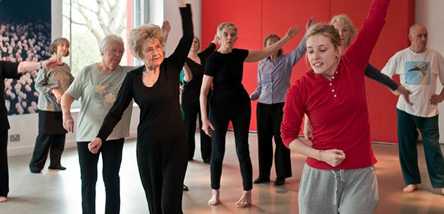
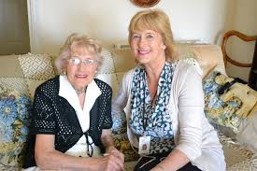
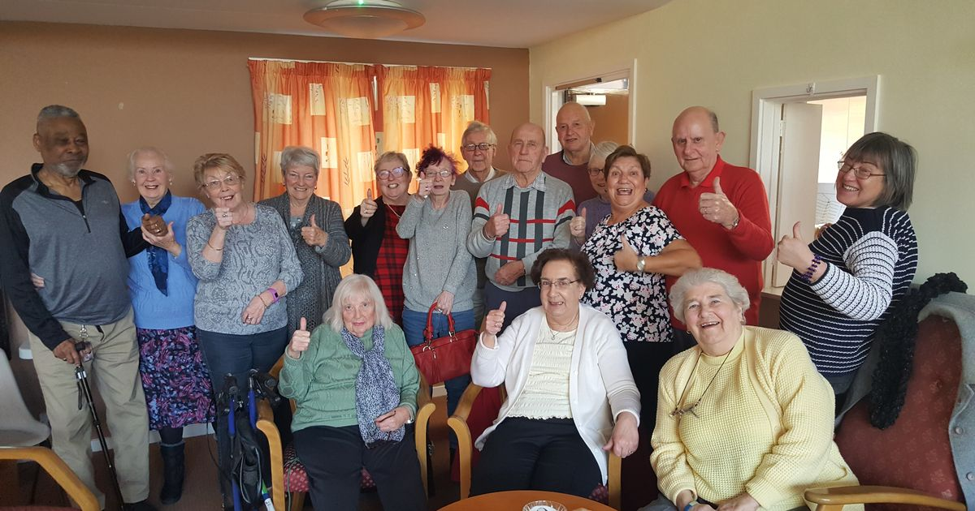
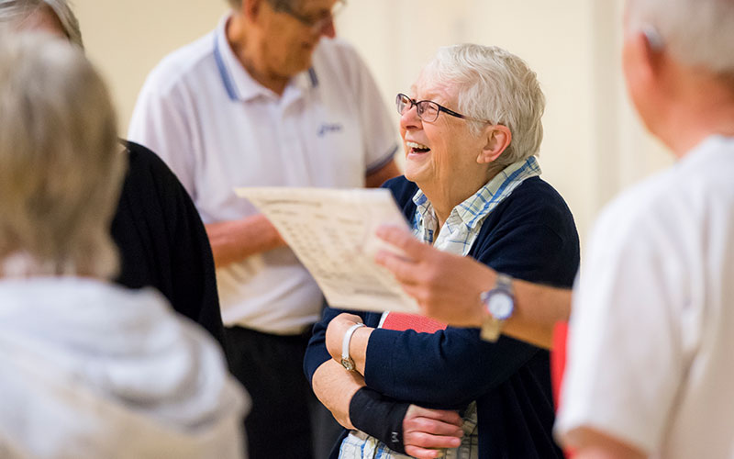
SERVICES
Dance classes
Arts and craft groups
Befriending services
University of
the Third Age
Day centres

Slide 20
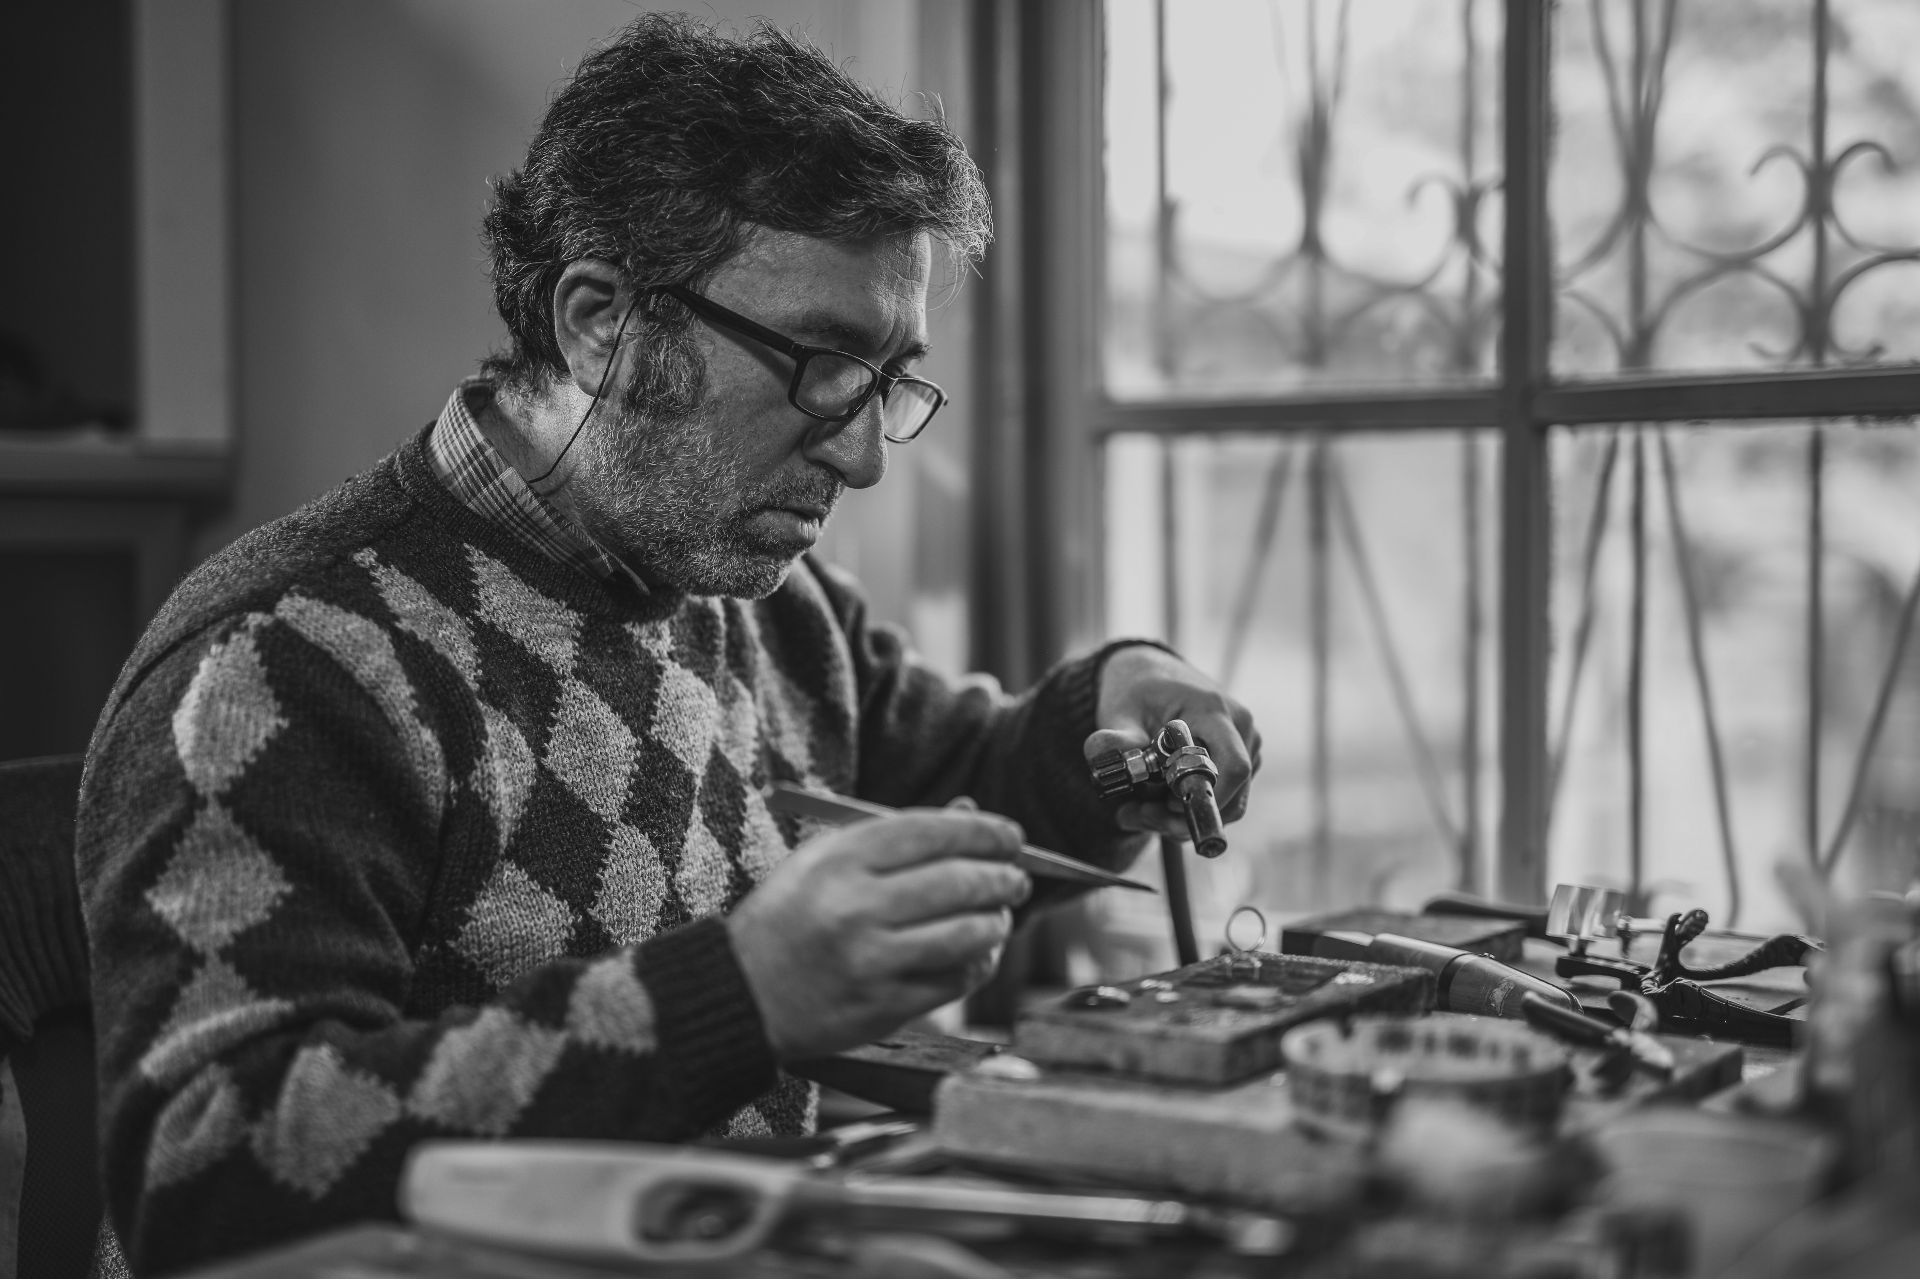
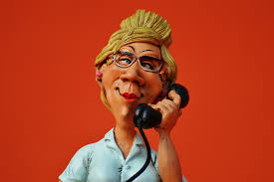
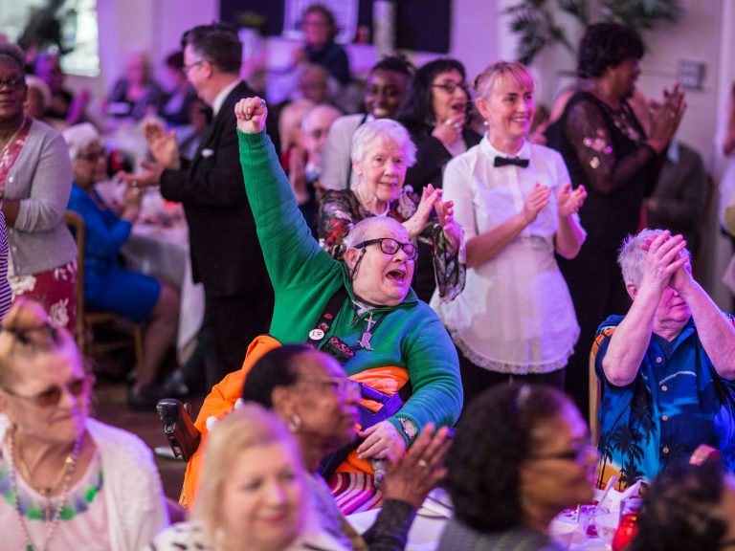
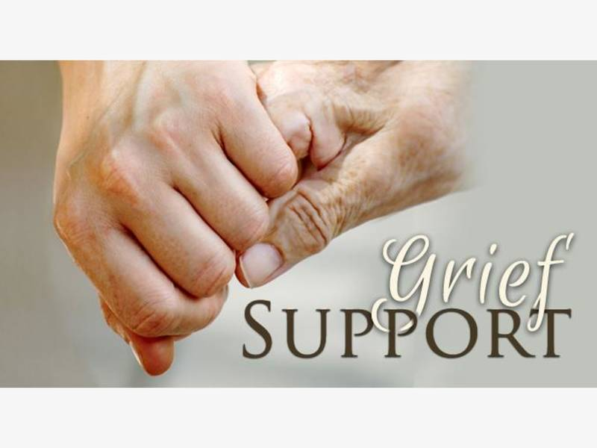
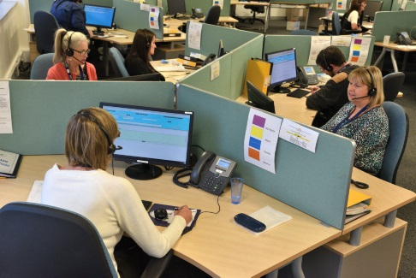
SERVICES
Telephone befriending
Men in Sheds groups
The Posh Club
The Silver Line
helpline
Bereavement support groups

Slide 21
THE POSH CLUB
A short film about the Posh Club

Slide 22
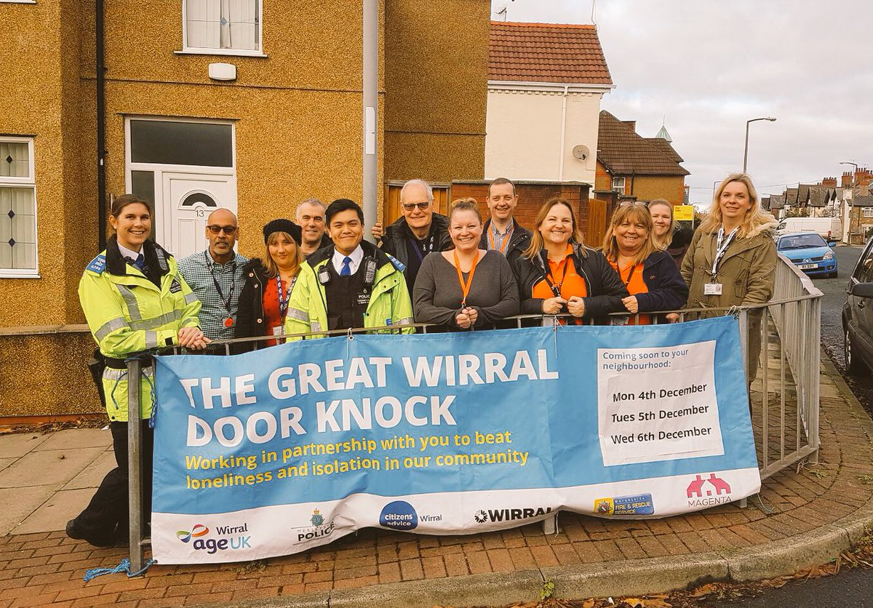
OUTREACH WORK
You may need to do some outreach work to identify the lonely older people in the streets where you live, in order to reach the ‘socially excluded’.
You can make use of telephone surveys and knocking on doors. One programme that employed such methods was the ‘Great Wirral Door Knock’, a local push to identify the ‘hidden lonely’ within the Metropolitan Borough of the Wirral.

Slide 23
THE GREAT WIRRAL DOOR KNOCK
The project used Age UK’s loneliness heat maps to identify communities most in need of support.
Those communities were then targeted by an army of volunteers, local councillors and staff led by Age UK Wirral working in partnership with Wirral CAB, Wirral Council, Merseyside Fire & Rescue, Merseyside Police and Merseytravel.
The team spent three days knocking on every door in the community handing out leaflets, and signposting people to local sources of support and activities, ranging from benefits advice and fire safety checks, to support groups and social activities.
The first Door Knock took place in the Mill Park estate:
…7 new attendees at local lunch clubs…
and 6 new volunteers for local community groups
…resulting in 78 referrals to support…
1,100 homes visited…..

Slide 24
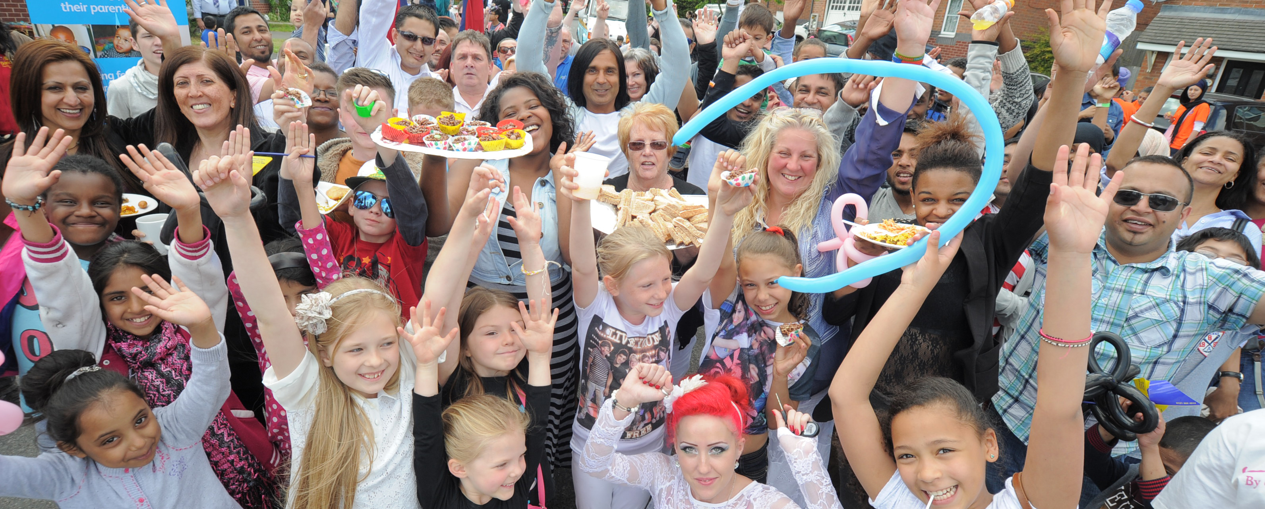
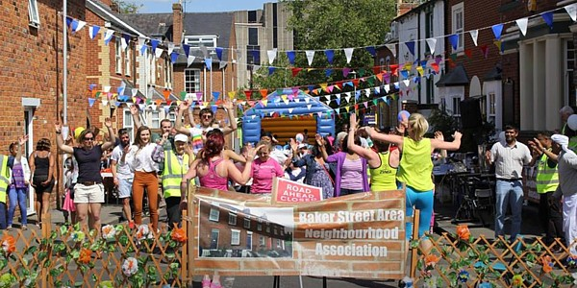
ORGANISE A BIG LUNCH
The Big Lunch was launched by the Eden Project in 2009 to encourage people to sit down to lunch with their neighbours. In 2017 around eight million people were estimated to have taken part in street parties and other events all over the UK.
OR…. A Great Get-Together
The Great Get-Together is a nationwide community event that was launched in 2017 in memory of the late loneliness campaigner Jo Cox MP. The project encourages people to organise local events such as street parties, sporting events, picnics, BBQs or coffee mornings.
Just Google ‘the Big Lunch’ or ‘the Great Get-Together’ to find out more.

Slide 25
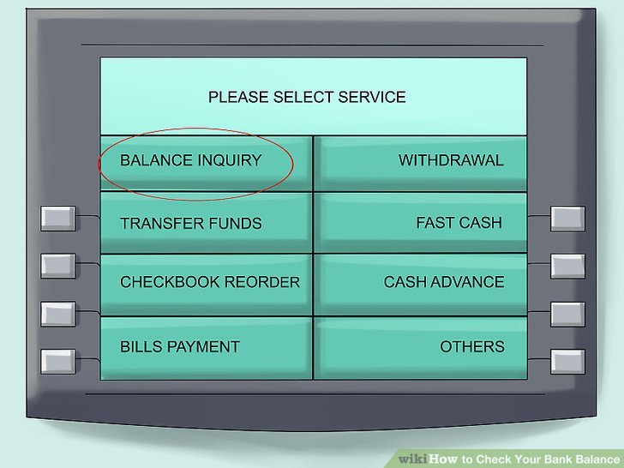
LOOK AFTER OURSELVES
It’s important to recognise that loneliness could affect us too, so we should value our friends and do what we can to sustain our own social networks, however busy our lives are.
We should check our relation-ship balances…..
…at least as often as we check our bank balances…
…and think about whether we’ve got the connections we need to keep us going.

Slide 26
THANK YOU
For more information about how to tackle loneliness in your community, please visit
www.ourwatch.org.uk/crimes-archive/loneliness-and-vulnerability
THANK YOU FOR LISTENING

